Slide 1
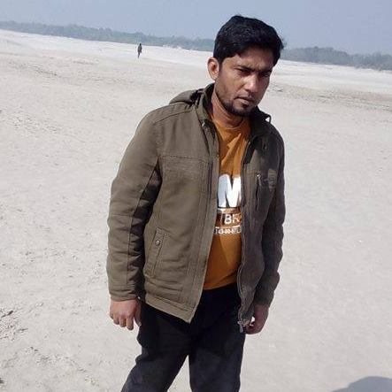
Parts of Speech
Md. Nur Kutubul Alam
Computer Teacher
Shapla kali Adarsha Scondary School
Jibannagar, Chuadanga

Slide 2
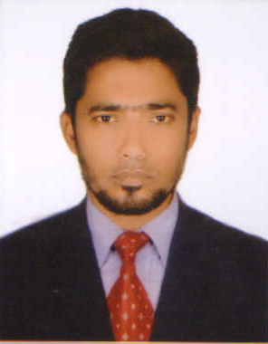
Verb
Rokon
He
is
a
teacher
Pronoun
Noun
Noun
Can you guys What are we going to learn-
Our Today Lesson is Parts of speech

Slide 3
Learning out comes- By the end of the lesson the students will be able to say –
1.What is the means of parts of speech ?
2. Identify Different kinds of parts of speech.
3. Use of parts of speech.

Slide 4
What Does Part of Speech Mean?
Each part of speech explains not what the word is but how the word is used.

Slide 5
The Eight Parts of Speech
Verb
Noun
Pronoun
Adjectives
Adverbs
Prepositions
Conjunctions
interjection
Home Page

Slide 6
More Details
Each part of speech explains not what the word is, but how the word is used. In fact, the same word can be a noun in one sentence and a verb or adjective in the next.

Slide 7
Adverbs
Adverb
An adverb can modify a verb, an adjective, another verb, a phrase, or a clause.
The seamstress quickly made the mourning clothes.
Home

Slide 8
Let’s Take a Closer Look!
Verb
A verb “is what you do!”
I will run, hop, and skip down the track.
Home

Slide 9
Here come the nouns!
Noun
A noun is a person place or thing.
Ms. Arruda is going to Vegas this weekend.
Home

Slide 10
Pronouns
Pronoun
A pronoun can replace the noun or another pronoun.
Which show do you want to see?
Home

Slide 11
Additional Pronouns
Personal Pronouns
A personal pronoun refers to specific person or thing and changes its form to indicate person, number, gender, and case.
Possessive Personal Pronouns
A possessive pronoun indicates that the pronoun is acting as a marker of possession and defines who owns a particular object or person.
(mine, yours, hers, his, its, ours theirs)
Home

Slide 12
Additional Pronouns Continued
Interrogative Pronouns
An interrogative pronoun is used to ask questions.
(who, whom, which, what and the compounds formed with suffix “ever”).
Home

Slide 13
Still More Pronouns!
Demonstrative Pronouns
A demonstrative pronoun points to and identifies a noun or a pronoun.
(this, that, these, and those are demonstrative pronouns)
Home

Slide 14
What about the Adjectives?
Adjectives
An adjective modifies a noun or pronoun by describing, identifying, or qualifying words.
The truck-shaped balloon floated over the treetops.
Home

Slide 15
Conjunctions
You can use Conjunctions to link words, phrases, and clauses.
I ate the pizza and the pasta!
Home

Slide 16
Prepositions
Prepositions
A preposition links nouns, pronouns, and phrases to other words in a sentence.
(on, against, over, during, beneath, beside)
Home

Slide 17
What is an Interjection?
Interjections
An interjection is a word added to a sentence to convey emotion.
(Ouch!, Hey!)
Home

Slide 18
Parts of Speech Poem by Kim Vetter
A noun’s the name of anything,
As house or garden, hoop, or swing.
Instead of nouns the pronouns stand-
Her head, your face, his arm, my hand.
Adjectives tell the kind of noun,
As great, small, pretty, white, or brown.
Verbs tell of something to be done-
To read, count, sing, talk, laugh, or run.
How things are done the adverbs tell,
As slowly, quickly, ill, or well.
Home

Slide 19
Poem Continued
Conjunctions join the words together, As men and women, wind or weather.
The preposition stands before
A noun, as in or through a door.
The interjection shows surprise,
As Oh! How Pretty; Ah! How wise.
That’s why we learn the parts of speech
Which reading, writing, speaking teach.
‘Cause grammar needs to be correct
To help you earn the world’s respect.

Slide 20
Single work
How many parts of speech in English Grammar ?
What is Noun?

Slide 21
Group Work
Write down the definition of pronoun and its classification
Write down four interjection word and its use.

Slide 22
Evaluation
Shapla Kali Adarsha Secondary School is one of the best school In Jibannagr
There are about 900 students. Mr. Baki billah is our Head Teacher. He is the Best
teacher. Hurray ! Our school is gained the best school prize in this year.
Say what parts of speech mention the yellow color?

Slide 23
Home Work
We live in the age of science. Science is the best way to know
others. Internet is one of them. For using of internet we live in
the global village. Who can go a single day without internet?
Write down the name of parts of speech (color words.)

Slide 24
Thanks to all
Thanks to all

